Slide 1
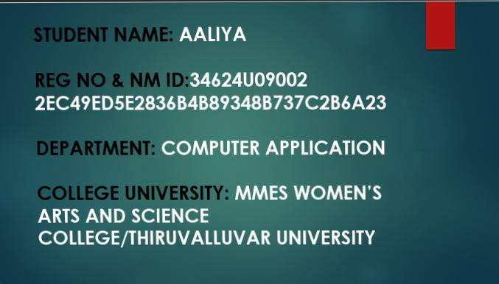

Slide 2
INTERACTIVE DIGITAL PORTFOLIO USING FRONT END DEVELOPMENT

Slide 3
Problem Statement:
🍁The problem statement defines the issue or challenge that your project aims to solve.
🍁For example:
"Create a user-friendly and visually appealing portfolio website to showcase my skills, projects, and experience as a web developer."

Slide 4
2. Project Overview:
💥The project overview provides a brief description of your project, including its purpose, goals, and target audience.
💥For example:
“My portfolio website is designed to showcase my web development skills, projects, and experience to potential employers, clients, and collaborators. The website will feature a clean and modern design, easy navigation, and interactive elements to engage visitors."

Slide 5
3. End Users:
🔥The end users section identifies the target audience for your project.
🔥 For example:
"The target audience for my portfolio website includes:
⭐Potential employers
⭐Clients
⭐Collaborators
⭐Peers and industry professionals"

Slide 6
4. Tools and Technologies:
➡️The tools and technologies section lists the software, programming languages, frameworks, and libraries used to build your project.
➡️ For example:
"The tools and technologies used to build my portfolio website include:
📌HTML5
📌CSS3
📌JavaScript
📌React
📌Bootstrap
📌GitHub Pages"

Slide 7
5. Portfolio Design and Layout:
✔️The portfolio design and layout section describes the visual design and layout of your website.
✔️ For example:
"My portfolio website features a modern and minimalist design with a focus on showcasing my projects and skills. The layout is clean and easy to navigate, with a responsive design that adapts to different screen sizes and devices."

Slide 8
6. Features and Functionality:
🚫The features and functionality section lists the key features and functionalities of your website.
🚫For example:
"My portfolio website includes the following features and functionalities:
💠Project showcase with images and descriptions
💠Skills and experience section
💠Contact form and social media links
💠Responsive design for mobile and tablet devices
💠Interactive elements such as animations and transitions"

Slide 9
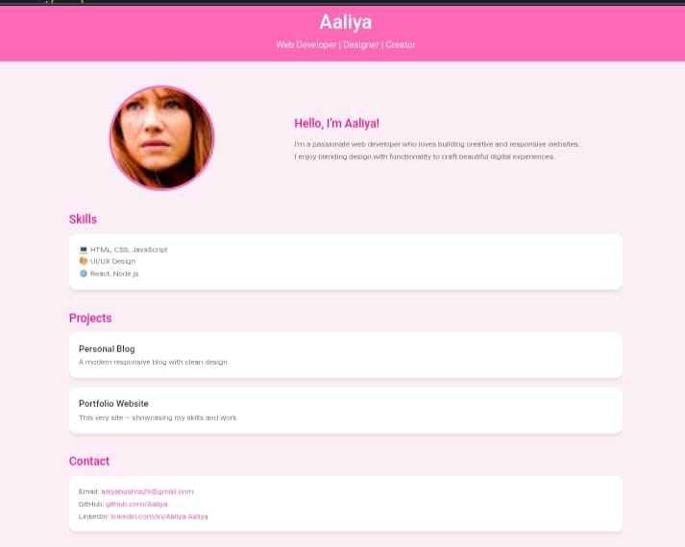
7. Result and Screenshot:
🍁The result and screenshot section showcases the final result of your project, including screenshots or images of your website.
🍁 For example:"Here is a screenshot of my portfolio website's homepage:

Slide 10
8. Conclusion:
📒The conclusion section summarizes the key takeaways from your project and reflects on what you learned or achieved.
📒For example:
"In conclusion, my portfolio website is a successful showcase of my web development skills and experience. I learned a lot about designing and building a responsive website, and I'm proud of the final result."

Slide 11
9. GitHub Link :
☄️The GitHub link section provides a link to your project's GitHub repository.
☄️For example:
"You can view the source code for my portfolio website on GitHub: https://github.com/aaliya"

